Slide 1
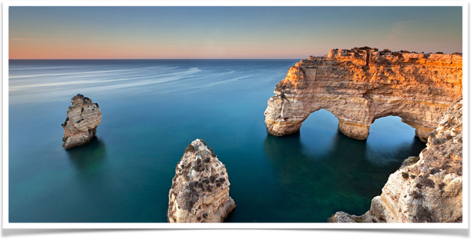
Building a basic search engine with apache lucene
ZHICHENG PAN 104639463 2017-10-23

Slide 2
outline
PROJECT INTRODUCTION
HOW TO IMPLEMENT STEP BY STEP
VIDEO REPRESENTATION
FUTURE WORK

Slide 3
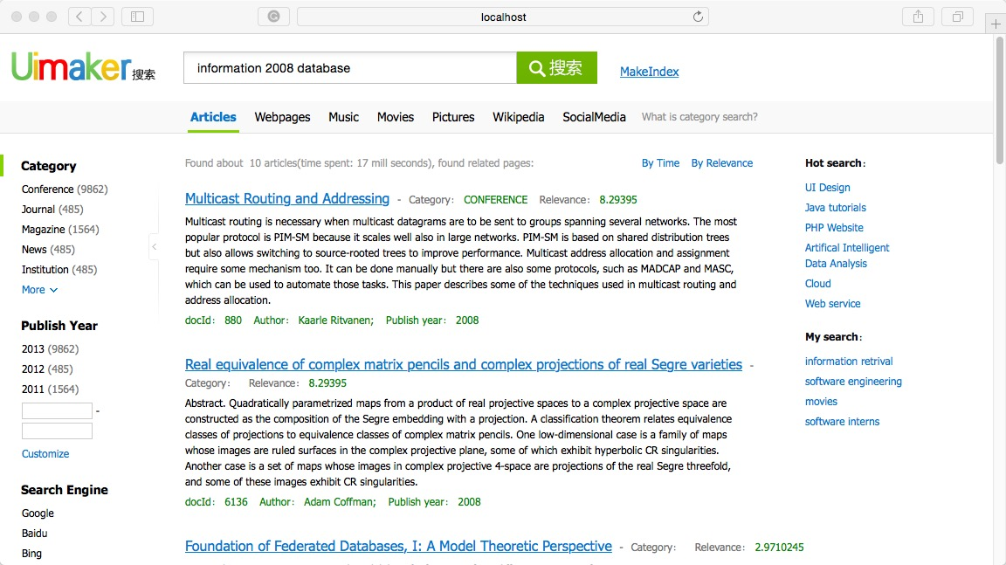
PROJECT INTRODUCTION
1. Use Spring Boot Framework to construct the project 2. Utilize the Lucene to build the core search engine 3. Provide UI interface by using Thymeleaf template engine

Slide 4
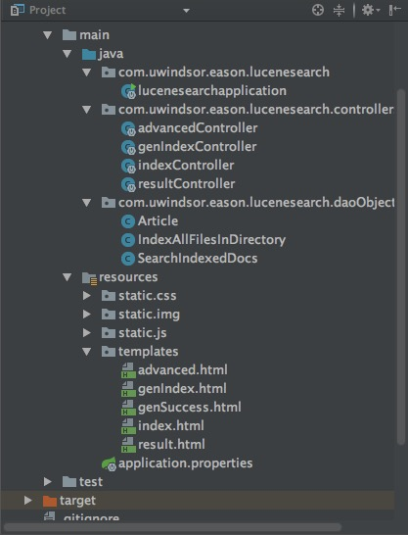
IMPLEMENT STEP1: construct project
1. establish the environment a). Maven 3.5, JDK 1.8, IntelliJ IDEA 14 (with Tomcat) b). Spring Boot 1.5.8, add dependencies: lucene, web, thymeleaf
2. design the modules layer for project a). Data layer: Lucene generate, manipulate data and provide data service for logical layer b). Logical layer: Spring MVC controller process the request and data c). Present layer: Thymeleaf engine combine data with web template, provide UI to end users 3. easy for adding more features

Slide 5

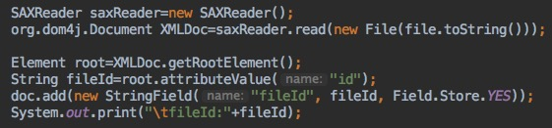
IMPLEMENT STEP 2: generate index
1. Prepare the papers data sets Content data : 10.1.1.2.1.txt …… Meta data : 10.1.1.2.1.xml ……
2. Parallel load the paired data sets, generate the index

Slide 6
IMPLEMENT STEP 3: Search the index
1. Multiple Fields Query String[] fields={“title”, “content”}; MultiFieldQueryParser parser=new MultiFieldQueryParser(fields, analyzer); parser.parse(keywords, fields, analyzer); Problems needed to be studied and researched: Problem 1: Query fields : {“title”, “content”} Keywords have to have two parts, like “data visualization” Problem 2: Which field of these two is weighting more ? Is it good for getting a better search outcome ?

Slide 7
IMPLEMENT STEP 4: Rank the papers
1. Using Lucene Relevance Score to rank the papers TopDocs topDocs = searcher.search(query, this.count); ScoreDoc[] scoreDocs = topDocs.scoreDocs; for (ScoreDoc scoreDoc : scoreDocs) { float score = scoreDoc.score;// to obtain the score }
Problems needed to be studied and researched: Problem 1: Relevant Scoring is not suitable for web pages Solution : Use PageRank to rank the webpages, calculating external references. For papers, need to calculate the external citations

Slide 8
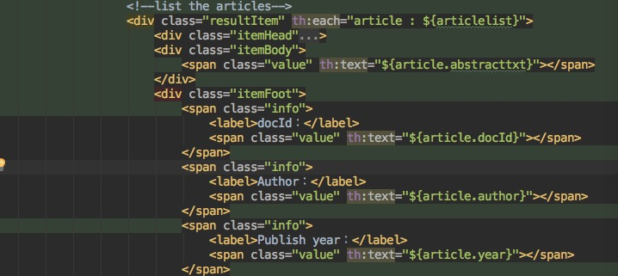
IMPLEMENT STEP 5: presenting results
1. Using Thymeleaf engine to provide dynamic webpages

Slide 9
VIDEO REPRESENTATION
VIDEO REPRESENTATION 1. show the key modules of the project 2. show how to create the index online 3. show multiple fields search results

Slide 10
FUTRE WORK
FUTRE WORK
A. Technical Improvements a). Highlight the keywords in a article b). Try to implement ”Search in Results” module B. Algorithms Enhancement a). Adding pagerank algorithms based on citations b). Adding Navie Bayers Classification algorithm c). Adding K-means/HAC Clustering algorithm

Slide 11

THANK YOU ! Q & A

